Slide 1
Vehicle Calculator
Artificial Intelligence design
By Brian Kilburn, Dominic Holt, and Jaime Wiess

Slide 2
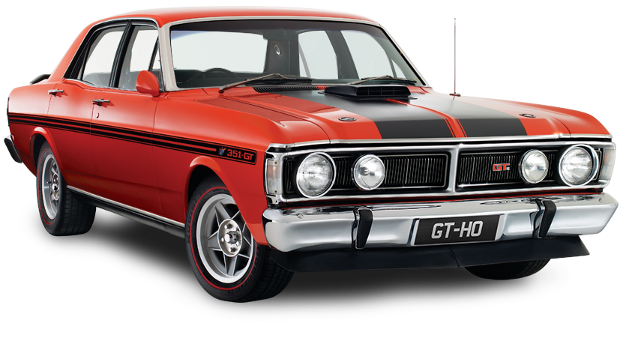
Vehicle industry
How do they come up with their pricing?

Slide 3
Vehicle industry
How do they come up with their pricing?

Slide 4
Vehicle industry
How do they come up with their pricing?
Origin

Slide 5
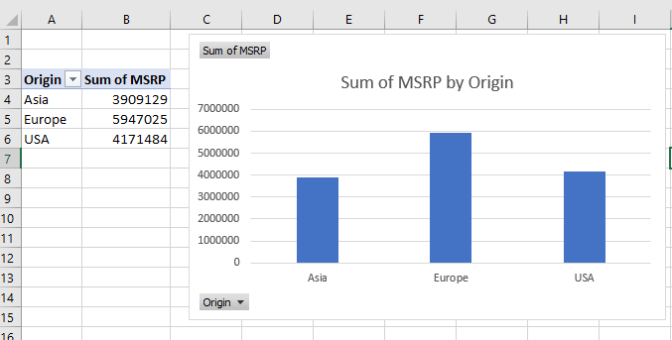
Vehicle industry
How do they come up with their pricing?
Origin:
Europe
Asia
USA

Slide 6
Vehicle industry
How do they come up with their pricing?
Origin
Make

Slide 7
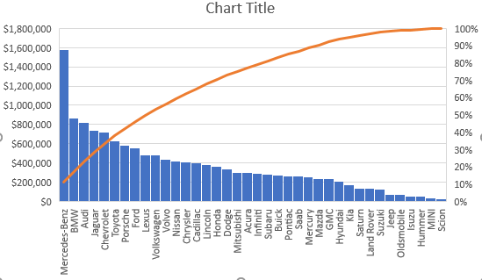
Vehicle industry
How do they come up with their pricing?
Make

Slide 9
Questions?

